Slide 2
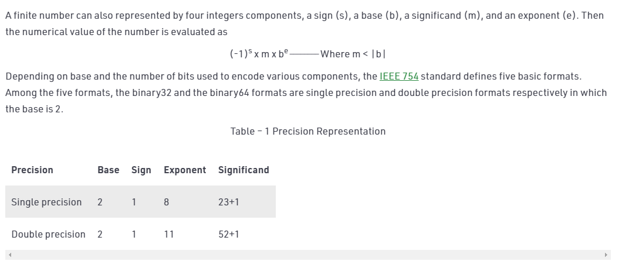

Slide 6
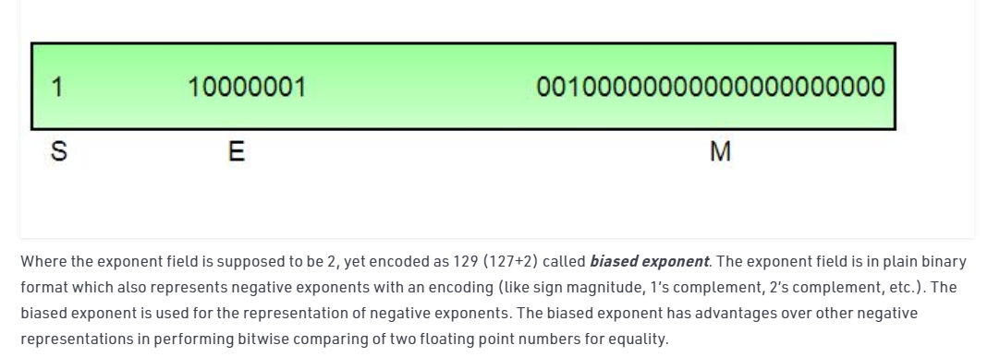

Slide 7


Slide 8


Slide 10
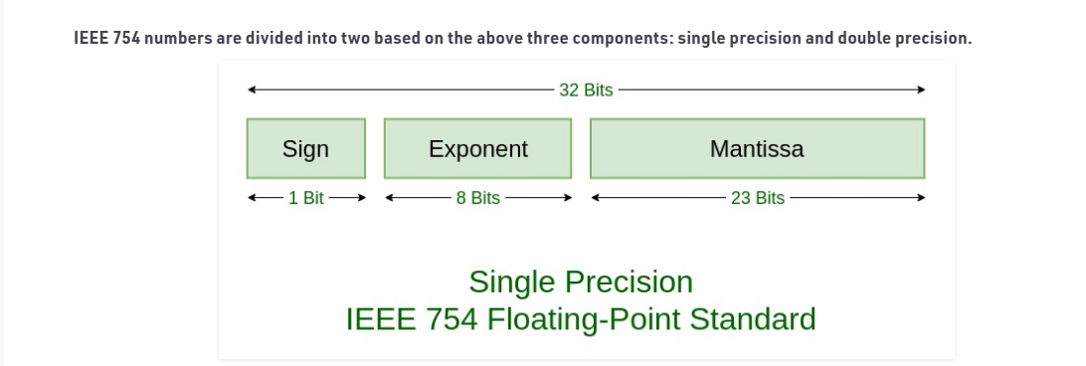

Slide 11
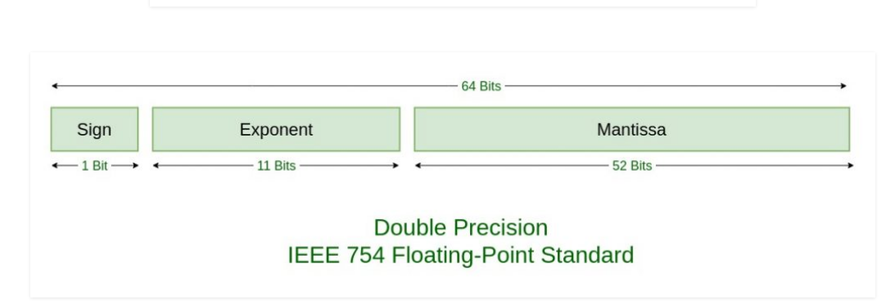

Slide 12
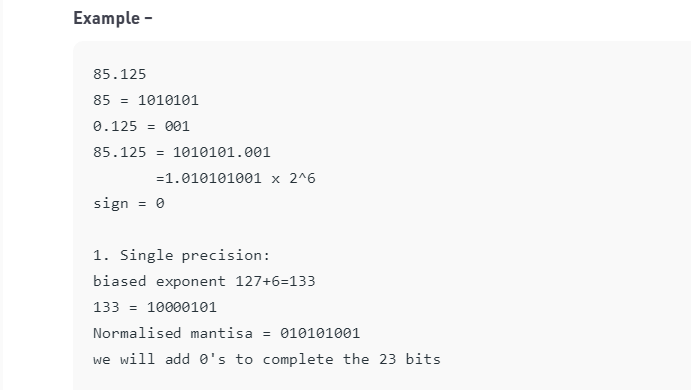


Slide 13


Slide 15





Slide 16



Slide 18
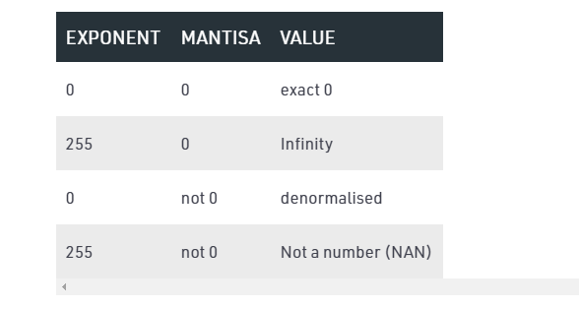

Slide 19


Slide 20


Slide 21
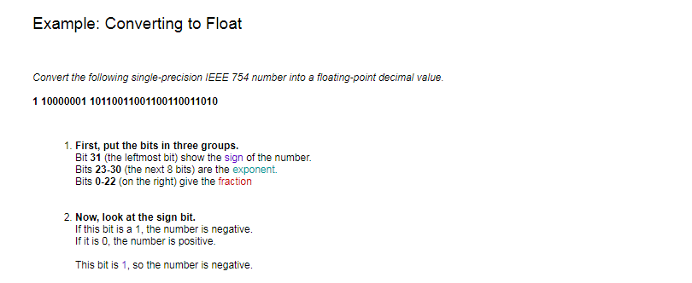

Slide 22
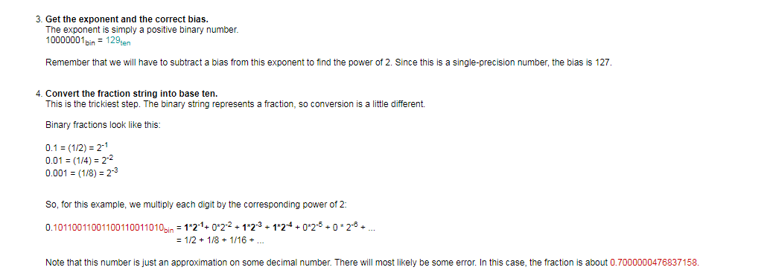

Slide 23


Slide 24
The integer 3,510,593 has hexadecimal representation
0x00359141, while the single-precision, floating-point number 3510593.0 has
hexadecimal representation 0x4A564504. Derive this floating-point representation and explain the correlation between the bits of the integer and floating-point representations.

Slide 25
